Slide 1
Schema registry

Slide 2
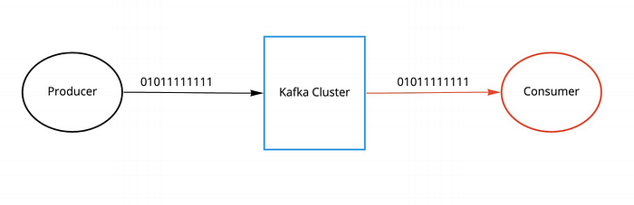
Without schema registry
No validation of input data
Producer can send poisoned data
Consumer will break when consuming poisoned data

Slide 3
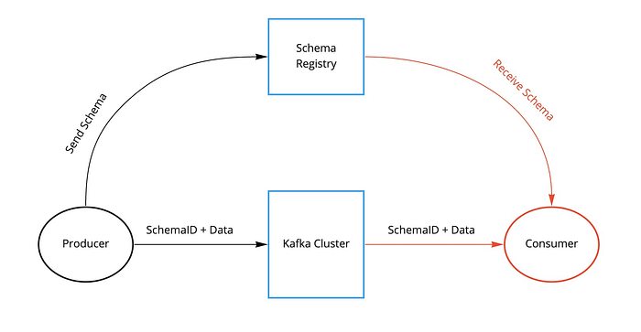
With schema registry
Before serialization the serializer checks if the schema exists in local cache (along with an id)
If not it tries to load it from the registry, and puts it in local cache.
If the schema is not in the registry, the serializer sends the schema to the registry and gets an id back (auto.register.schemas turned on)
If the above fails the serializer aborts
Before deserialization the consumer checks if the schema exists in local cache (by id)
If not it tries to load if from the registry and puts it in local cache.
Upon success the message is deserialized
The consumer need not know the schema in advance

Slide 4
Protobuf schema
syntax = "proto3";
option java_package = "com.example.tutorial.protos";
message SimpleMessage {
string content = 1;
string date_time = 2;
}
message Order {
int64 order_id = 1;
int64 date_time = 2;
repeated Product product = 3;
}
message Product {
int32 product_id = 1;
string name = 2;
string description = 3;
}
More complex datatypes

Slide 5
Generating code in java
<plugin>
<groupId>com.github.os72</groupId>
<artifactId>protoc-jar-maven-plugin</artifactId>
<version>3.11.4</version>
<executions>
<execution>
<phase>generate-sources</phase>
<goals>
<goal>run</goal>
</goals>
<configuration>
<inputDirectories>
<include>${project.basedir}/src/main/protobuf</include>
</inputDirectories>
<outputTargets>
<outputTarget>
<type>java</type>
<addSources>main</addSources>
<outputDirectory>${project.basedir}/target/generated-sources/protobuf</outputDirectory>
</outputTarget>
</outputTargets>
</configuration>
</execution>
</executions>
</plugin>
<dependencies>
<dependency>
<groupId>com.google.protobuf</groupId>
<artifactId>protobuf-java</artifactId>
<version>3.12.2</version>
</dependency>
</dependencies>

Slide 6
Writing producer
Properties properties = new Properties();
properties.put(ProducerConfig.BOOTSTRAP_SERVERS_CONFIG, "localhost:9092");
properties.put(ProducerConfig.KEY_SERIALIZER_CLASS_CONFIG, StringSerializer.class);
properties.put(ProducerConfig.VALUE_SERIALIZER_CLASS_CONFIG, KafkaProtobufSerializer.class);
properties.put(KafkaProtobufSerializerConfig.SCHEMA_REGISTRY_URL_CONFIG, "http://localhost:8081");
properties.put("auto.register.schemas", false);
Producer<String, SimpleMessage> producer = new KafkaProducer<>(properties);
SimpleMessage simpleMessage = SimpleMessage.newBuilder()
.setContent("Hello world")
.setDateTime(Instant.now().toString())
.build();
ProducerRecord<String, SimpleMessage> record = new ProducerRecord<>("protobuf-topic", null, simpleMessage);
producer.send(record);
producer.flush();
producer.close();
Register schema if it does not exist
Serializer and pointer to registry

Slide 7
Writing consumer
Properties properties = new Properties();
properties.put(ProducerConfig.BOOTSTRAP_SERVERS_CONFIG, "localhost:9092");
properties.put(ConsumerConfig.GROUP_ID_CONFIG, "protobuf-consumer-group");
properties.put(ConsumerConfig.AUTO_OFFSET_RESET_CONFIG, "earliest");
properties.put(ConsumerConfig.ENABLE_AUTO_COMMIT_CONFIG, false);
properties.put(ConsumerConfig.KEY_DESERIALIZER_CLASS_CONFIG, StringDeserializer.class);
properties.put(ConsumerConfig.VALUE_DESERIALIZER_CLASS_CONFIG, KafkaProtobufDeserializer.class);
properties.put(KafkaProtobufDeserializerConfig.SCHEMA_REGISTRY_URL_CONFIG, "http://localhost:8081");
properties.put(KafkaProtobufDeserializerConfig.SPECIFIC_PROTOBUF_VALUE_TYPE, SimpleMessage.class.getName());
KafkaConsumer<String, SimpleMessage> consumer = new KafkaConsumer<>(properties);
consumer.subscribe(Collections.singleton("protobuf-topic"));
while (true) {
ConsumerRecords<String, SimpleMessage> records = consumer.poll(Duration.ofMillis(100));
for (ConsumerRecord<String, SimpleMessage> record : records) {
System.out.println("Message content: " + record.value().getContent());
System.out.println("Message time: " + record.value().getDateTime());
}
consumer.commitAsync();
}
Deserializer and pointer to registry
Class to deserialize to

Slide 8
Writing generic consumer
Properties properties = new Properties();
properties.put(ProducerConfig.BOOTSTRAP_SERVERS_CONFIG, "localhost:9092");
properties.put(ConsumerConfig.GROUP_ID_CONFIG, "generic-protobuf-consumer-group");
properties.put(ConsumerConfig.AUTO_OFFSET_RESET_CONFIG, "earliest");
properties.put(ConsumerConfig.ENABLE_AUTO_COMMIT_CONFIG, false);
properties.put(ConsumerConfig.KEY_DESERIALIZER_CLASS_CONFIG, StringDeserializer.class);
properties.put(ConsumerConfig.VALUE_DESERIALIZER_CLASS_CONFIG, KafkaProtobufDeserializer.class);
properties.put(KafkaProtobufDeserializerConfig.SCHEMA_REGISTRY_URL_CONFIG, "http://localhost:8081");
KafkaConsumer<String, SimpleMessage> consumer = new KafkaConsumer<>(properties);
consumer.subscribe(Collections.singleton("protobuf-topic"));
while (true) {
ConsumerRecords<String, DynamicMessage> records = consumer.poll(Duration.ofMillis(100));
for (ConsumerRecord<String, DynamicMessage> record : records) {
for (FieldDescriptor field : record.value().getAllFields().keySet()) {
System.out.println(field.getName() + ": " + record.value().getField(field));
}
}
consumer.commitAsync();
}
Dynamic class
Deserializer and pointer to registry

Slide 9
Interacting with schema registry
http://localhost:8085/subjects
[
“Hello-topic-value”
]
http://localhost:8085/subjects/Hello-topic-value/versions
[
1,
2
]
Use POST + DELETE + PATCH operations to change
configurations and create, update and delete schemas
http://localhost:8085/config
{
"compatibilityLevel": "BACKWARD"
}
http://localhost:8085/subjects/Hello-topic-value/versions/1
{
"subject": "hello-topic-value",
"version": 1,
"id": 1,
"schemaType": "PROTOBUF",
"schema": "syntax = \"proto3\";\n\noption java_package = \"com.example.tutorial.protos\";\n\nmessage HelloWorld {\n string message = 1;\n string message_1 = 2;\n}\n"
}
Default compatibility

Slide 10
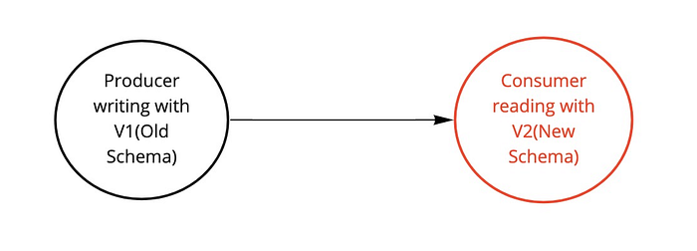
Backward compatible

Slide 11
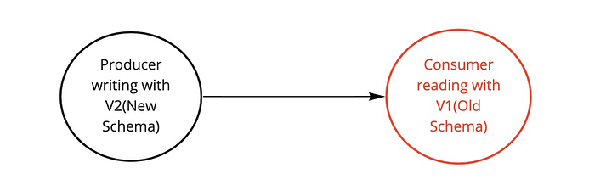
Forward compatible

Slide 12
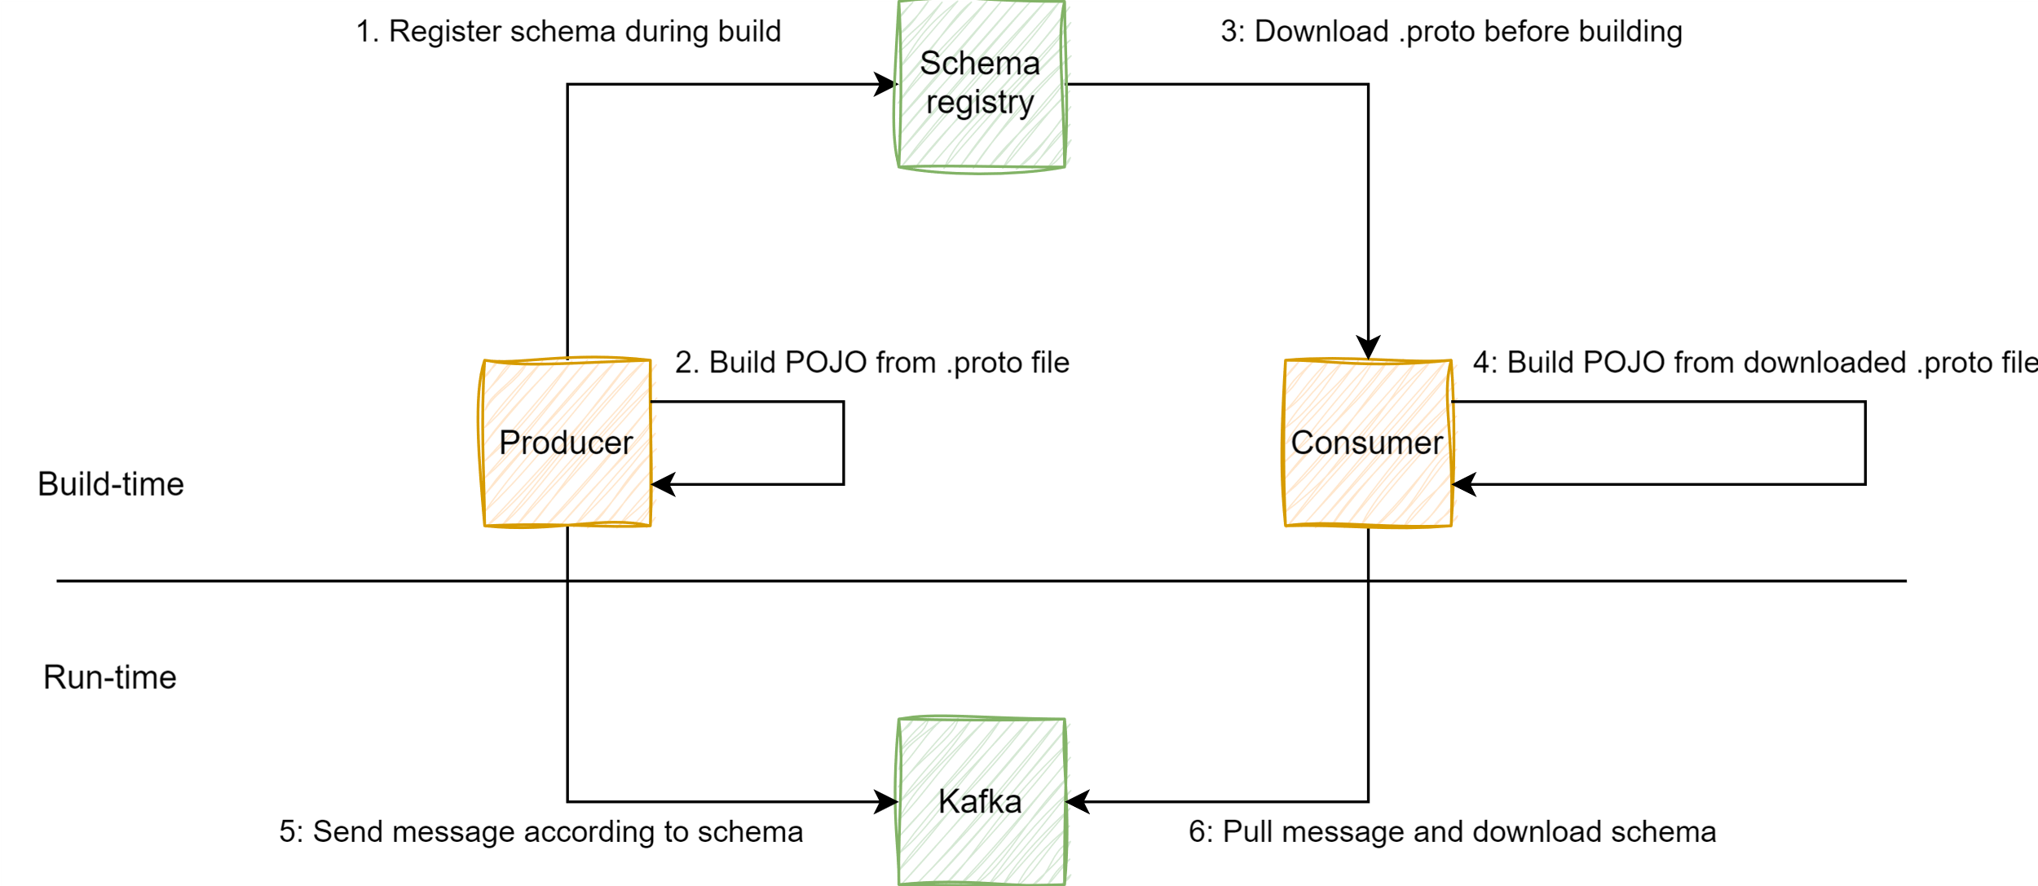
Example

